Slide 1








SHIP Internship
2024
MARIBETH GRAY

Slide 2




“I wish there were opportunities the adults could participate in as well. These activities make me miss being younger.”
Research
“Is there any activity that I can participate with my kids?”
Here are some discussions I had with the parents of the children (both males and females) to inform the development my idea.
“Could the adults have the opportunity to color? I still find joy in it.”

Slide 3
MY TIME IN ACTIVITIES
  While working as an intern in activities at Country Cascades Waterpark Resort, I have engaged in meaningful conversations with the families staying at the hotel.
  I have also had the opportunity to participate in the evening dance parties that are hosted.
  One activity that consistently attracts attention is the coloring activities. I have had parents express interest in coloring alongside their children, and many children have requested additional coloring pages and expressed a desire to color throughout the day.
  I wanted to create an event that would be enjoyable for both parents and children. After engaging in conversations with parents, I brainstormed several ideas to attract a larger crowd to join the dance parties.

Slide 4
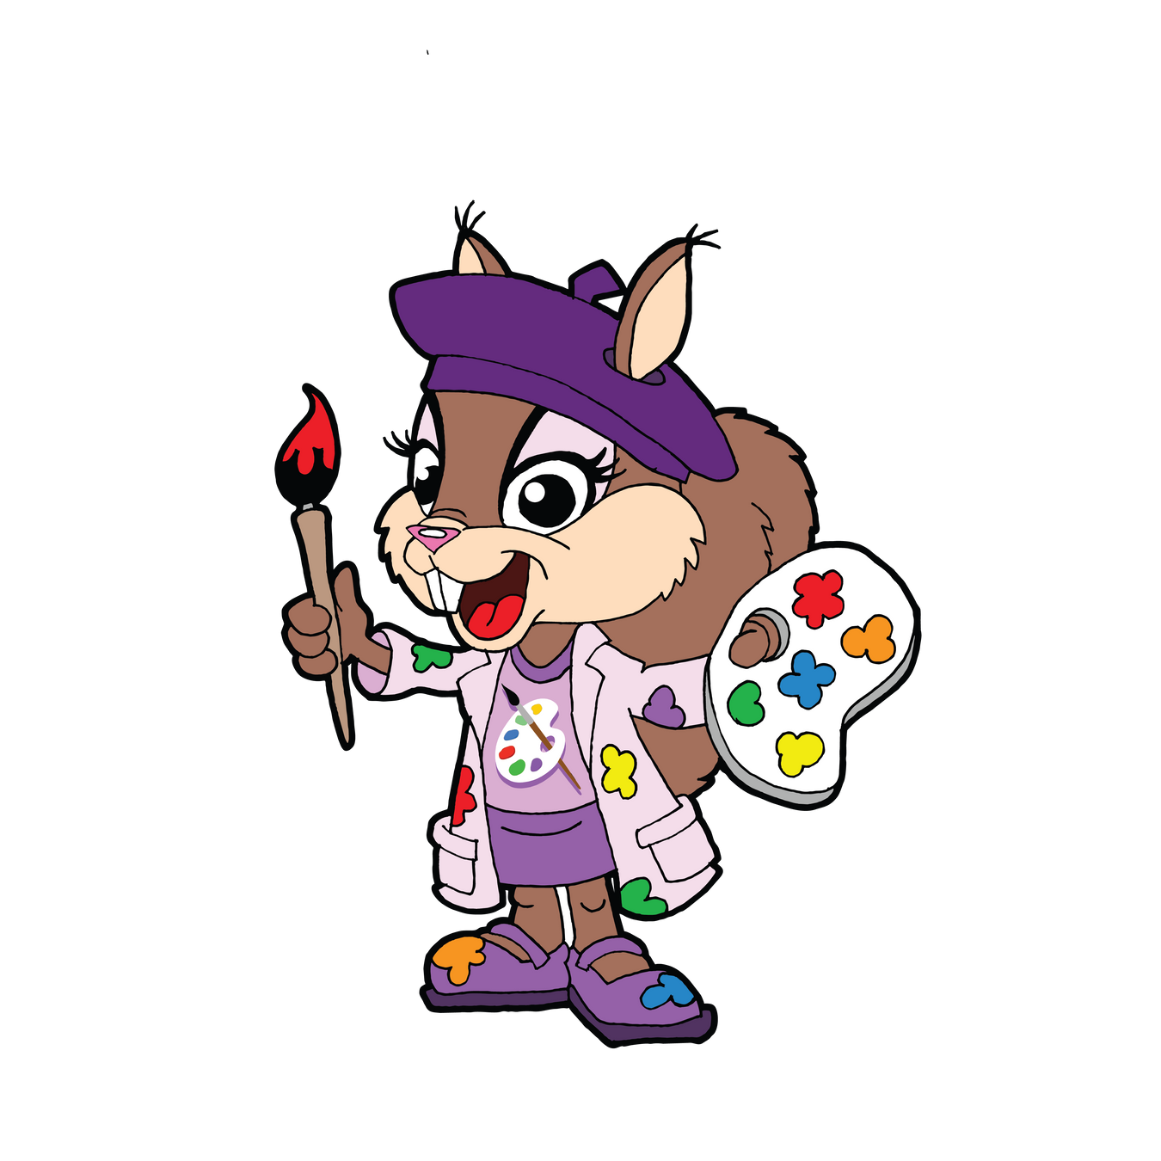

Selena’s Palette of Friendship
CONCEPT #1
I have the idea to create a branded coloring book for both kids and adults. Within this book it will contain:
  Create on InDesign (at no cost)
  1 page for each character. Each character will have an activity
page to go along with them
  Affirmation words need to be one of the pages (unscramble activity)
  Include some activity pages
Word search
Fill in the blank
Complete the maze

Slide 5




SWOT Analysis- Idea #1
STRENGTHS
OPPORTUNITIES
Gives children and their parents to explore their creativity.
Coloring is known as a stress reducer.
This activity is educational.
Bonding time with parents and children.
This is an activity they can take home and continue their adventure.
The back page will include the social media links to help grow our engagement.
WEAKNESSES
THREATS
They cannot take more than one copy per child.
Will have to require ink, copy paper, and colored pencils.

Slide 6
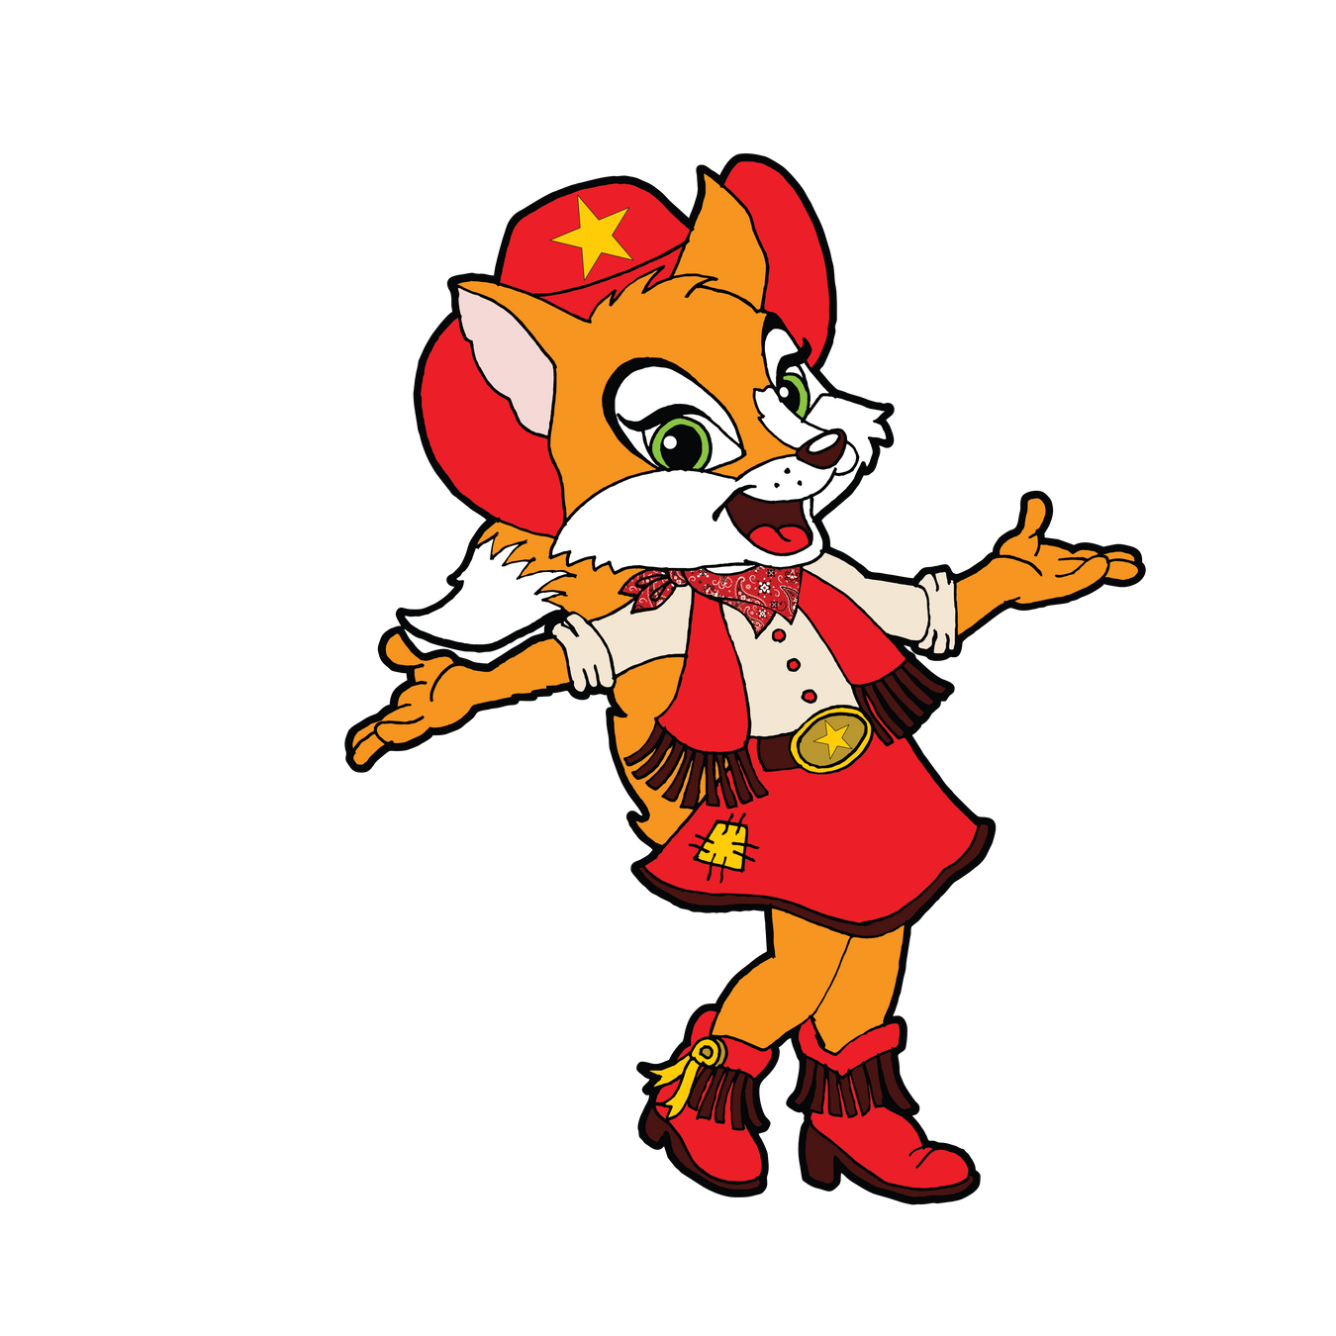
Fracilla’s
Foxy
Footwork
CONCEPT #2
  I have developed an idea for a line dancing night centered around Fracilla, titled "Fracilla’s Foxy Footwork."
  This event could replace the usual evening dance party and will be advertised as an opportunity for attendees to come dressed in their cowboy boots for a fun and engaging experience.

Slide 7


SWOT Analysis- Idea #2
STRENGTHS
OPPORTUNITIES
This event provides an opportunity for parents and adults to actively participate, rather than sitting on the sidelines while their children engage in activities.
This gives a open variety of music option to match age groups so it is not directed to younger audience.
This initiative aims to increase engagement from the older audience, fostering participation beyond just the children.
This event can be effectively promoted to attract more visitors to Country Cascades.
Can advertise Fracilla’s products in The Outpost.
WEAKNESSES
THREATS
We will ensure that song selections remain family-friendly, so we won't be able to accept specific song suggestions.
Will have to create a new playlist and dance moves for this night.

Slide 8
THANK YOU!

